Slide 1

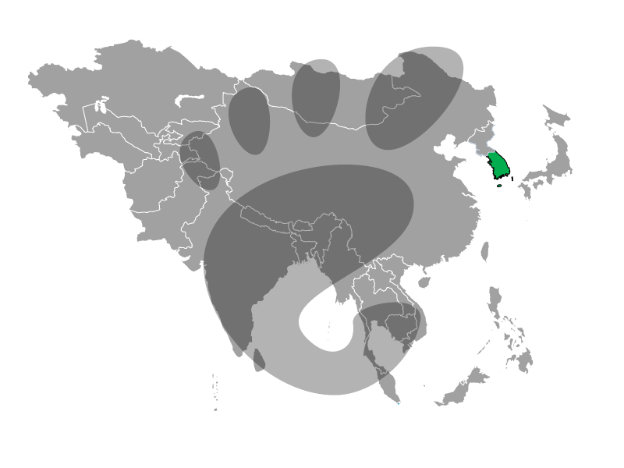

The soul's code of Taiwan campus
soul's code
The soul's code of Taiwan campus
ericsun

Slide 2
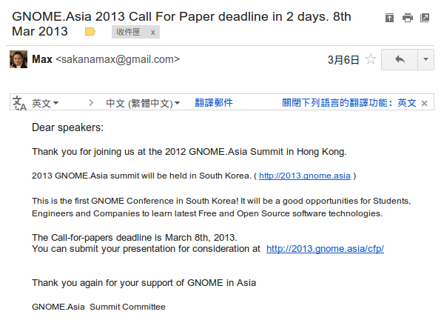
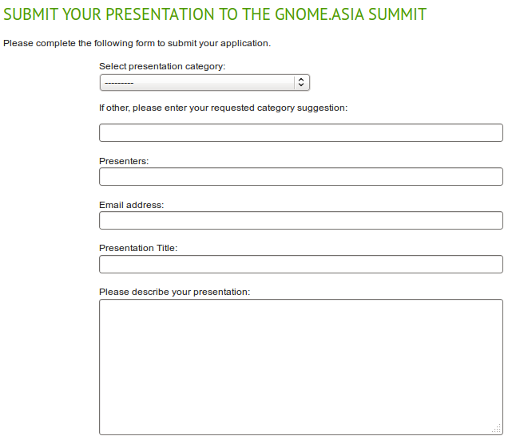
What I can share with you in this talk
?

Slide 3

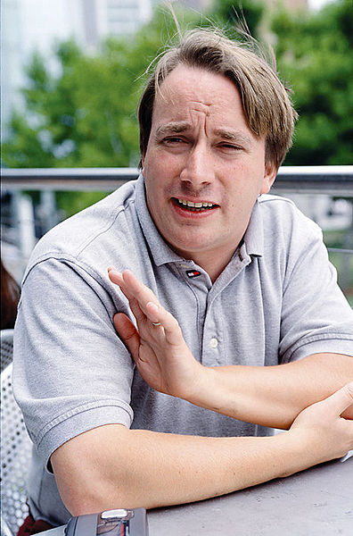
Talk is cheap,
show me the code!

Slide 4

Talk is cheap,
show me the code!
This reminded me that if I don't say something about codes,
there's no point in coming here. However, it is not an easy task for me,
since I have never contributed one single line of code all these years
that I use free and open source software. It made me fully understand
how great you open source software developers are.
I really appreciate all the efforts you put in these wonderful
free and open source software.

Slide 5
What can I share
in this great summit?
What can I share
in this great summit?

Slide 6
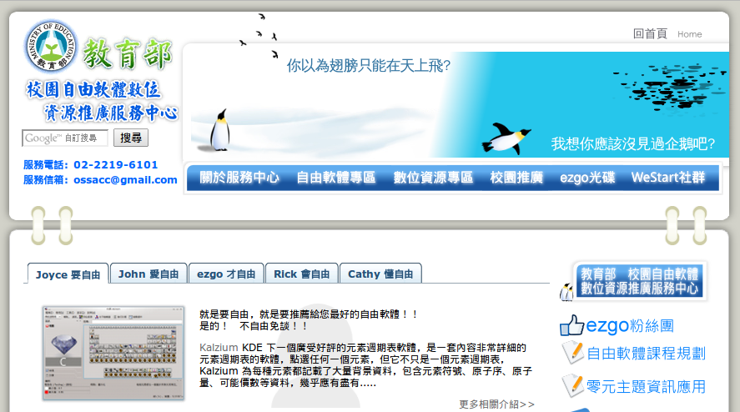
OSSACC is
OSS APPLICATION CONSULTING CENTRE
organized by the Ministry of Education

Slide 7
The goals of OSSACC
Assist all schools ...
  elementary & high schools using OSS
  & integrating those software into
  the education & daily routines in schools.
Assist them resolve ...
  the problems they encounter, including operation, technical & training problems.
Notes:
The goals of this project are to assist all pilot elementary and high schools
using open source softwares and integrating those softwares
into educational and daily routines in schools.
We try our best helping them resolve the problems they encounter,
including operation, technical and training problems.
In 25 cities and counties in Taiwan,
there were 50 pilot schools in 2005,
and the number of schools doubles this year.

Slide 8
I decided to share with all of you about
what kinds of thoughts and ideas we have in promoting the free and open source
software on Taiwanese campuses.

Slide 9
8 years ago
Proprietary softwares
8 years ago, the computer classes in all schools in Taiwan still taught Microsoft Office. At that time, what we thought about was how to promote free and open software in computer classes.
Our ideas were still at the level of how to "replace" commercial software with free and open source software.
Open source softwares
New choices
(alternative solutions)
．Linux
．Open Office
．Gimp
．...
Notes:
We don't want to advocate open source softwares merely for
open source softwares,
instead, we think the most important goal in information education is
to cultivate students with the ability to using technology and information.
In the past, we tend to focus on replacing proprietary softwares with
open source softwares,
however, this may not be attractive to general users.
General users are already used to the existing proprietary softwares,
they will only consider adopting open source softwares for licensing or
budget reasons.
In this way, users will not gain new abilities on information application from using open source softwares.
Therefore, we will introduce open source softwares as new applications instead of alternative choices other than existing proprietary softwares in the future.
Moreover, we hope to enhance teachers' information abilities in teaching and administration via promoting open source softwares,
in this way, we hope to achieve our ultimate goal: integrate information technologies into education.

Slide 10
Free software is not only in computer class
30
Free Software
Free Software
1
computer class
other classes

Slide 11
The choices of OSS
Proprietary softwares
Proprietary softwares
Open source softwares
Open source softwares
New choices
(alternative solutions)
．Linux
．Open Office
．Gimp
．...
New applications
(solutions)
．Freemind
．moodle
．XOOPS
．...
Notes:
We don't want to advocate open source softwares merely for
open source softwares,
instead, we think the most important goal in information education is
to cultivate students with the ability to using technology and information.
In the past, we tend to focus on replacing proprietary softwares with
open source softwares,
however, this may not be attractive to general users.
General users are already used to the existing proprietary softwares,
they will only consider adopting open source softwares for licensing or
budget reasons.
In this way, users will not gain new abilities on information application from using open source softwares.
Therefore, we will introduce open source softwares as new applications instead of alternative choices other than existing proprietary softwares in the future.
Moreover, we hope to enhance teachers' information abilities in teaching and administration via promoting open source softwares,
in this way, we hope to achieve our ultimate goal: integrate information technologies into education.

Slide 12

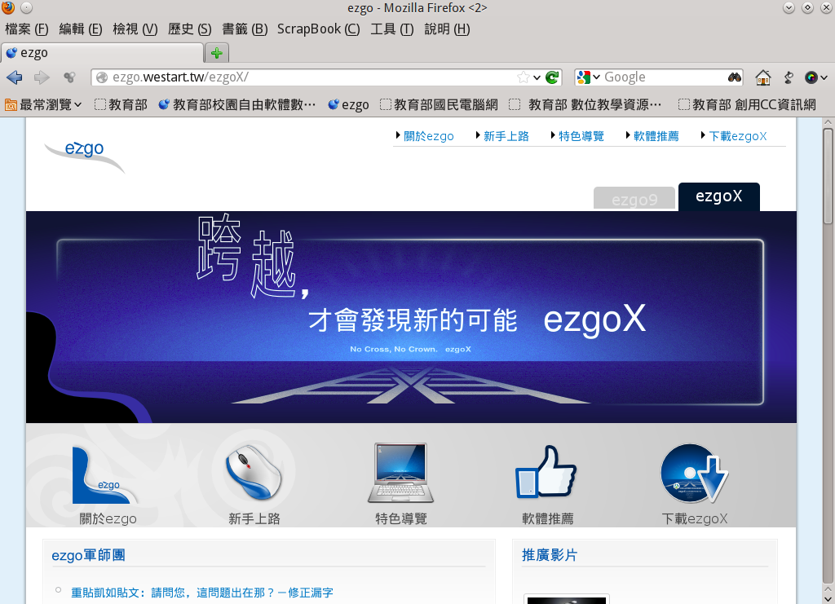
What is ezgo?

Slide 13
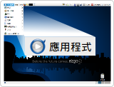
Make free software simple
Mandriva
Ubuntu
Fedora
Suse
Debian
...
Mandriva
Ubuntu
Fedora
Suse
Debian
...
Gnome
KDE
LXDE
...
Gnome
KDE
LXDE
...
X Window

Slide 14
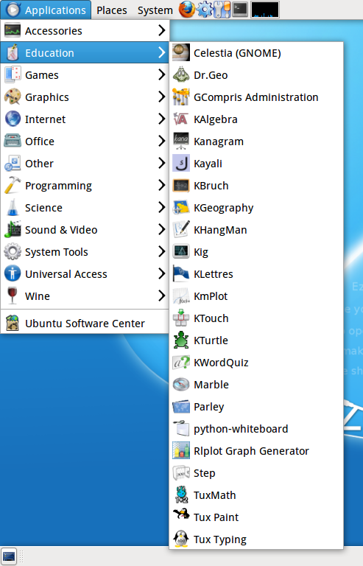
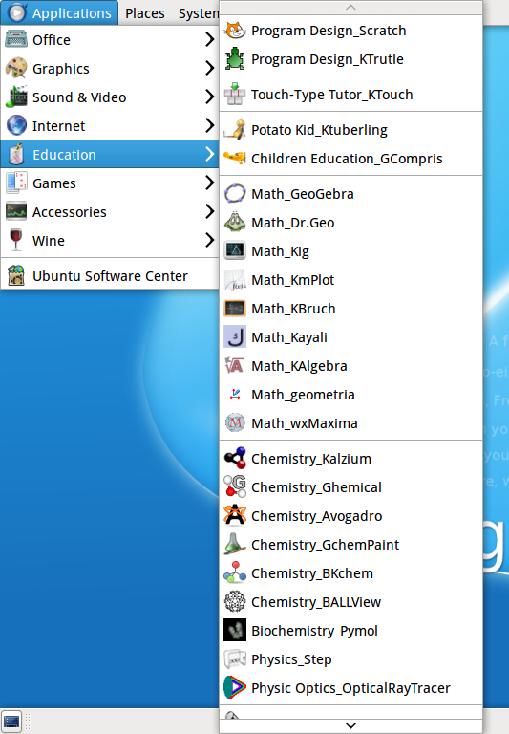

Slide 15

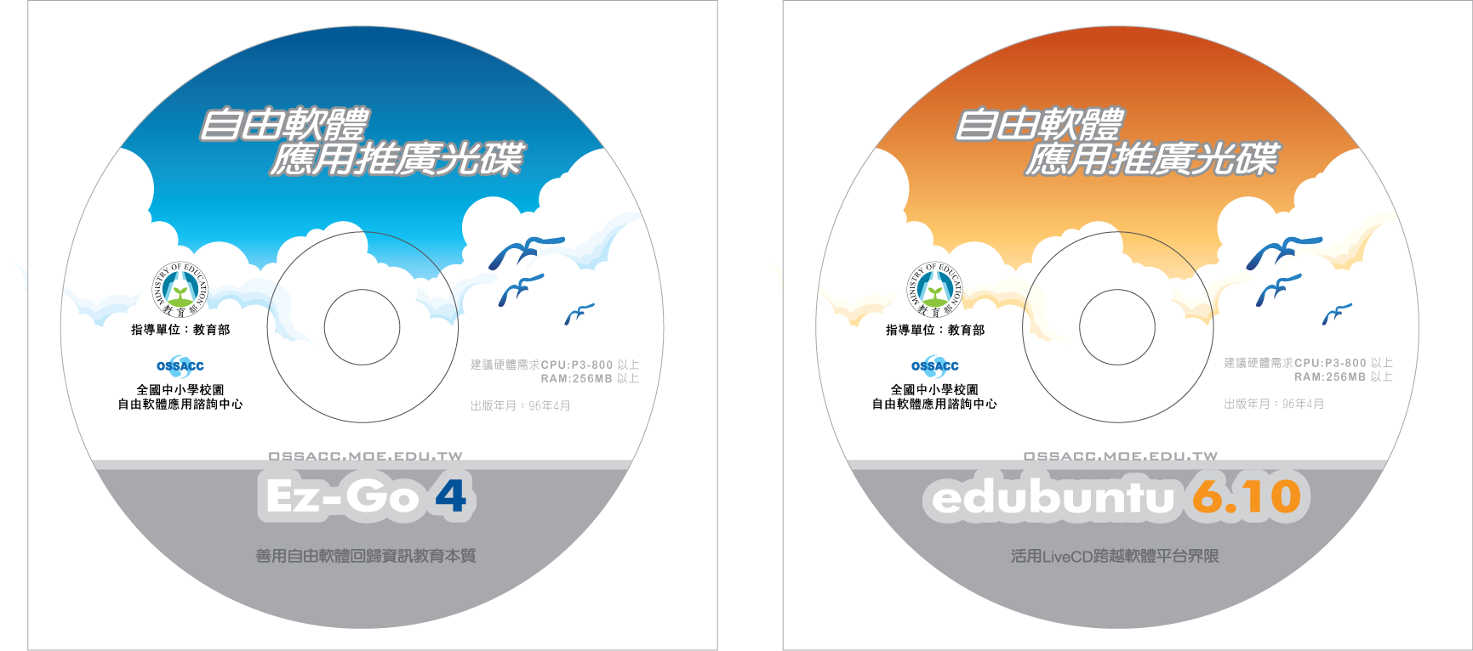


Slide 16

From ezgo 6,
we started to think about the following questions:
How can we add some localized thoughts and
ideas in Linux?
Can we assign a special meaning to each
version of ezgo?

Slide 17

You can't fly with only one wing.
You won't fly if you only have a right wing. We also need a left wing, so that we can
fly in the sky, freely.
This design was meant to remind people of this wing, a wing unknown or forgotten by people in Taiwan all these years.

Slide 18

We wanted to remind people that both commercial software and free software exist in this world.
We hope to let people understand the real needs and values of software applications.
We don't need to use one to replace the other.
We don't need to be blocked - this is not a single-choice question.

Slide 19

We hope people understand
that in the world of computers,
there are not only commercial software,
but also free and open source software.
If people understand what they want,
and have the free will to choose which
to use,It could be a win-win situation.

Slide 20

What do you think it is on the bottom left?

Slide 21

ezgo is a project that stands on
a giant's shoulder, and this "giant"
is based on Linux. So we put the name
"ezgo" on the giant's shoulder, and put
our slogan "This is the right way" after it,
telling people that THIS is the right direction!

Slide 22

One student in our developing team gave us this good analogy between free and commercial software: Free and open source software is just like star night, and commercial software is just like the light pollution in the cities.

Slide 23

We live in big cities for so long that we
are not aware of the beauty of a quiet, beautiful night full of stars.
If we are willing to leave big cities and
lie on the grass, without any light pollution, anyone could enjoy this beautiful sky
full of stars, freely.

Slide 24
ezgo10
ezgo X

Slide 25


Slide 26


Slide 27

We decided to use ezgo X instead of ezgo 10,
then we started to find design ideas about X.
Can you see what kind of X it is?

Slide 28
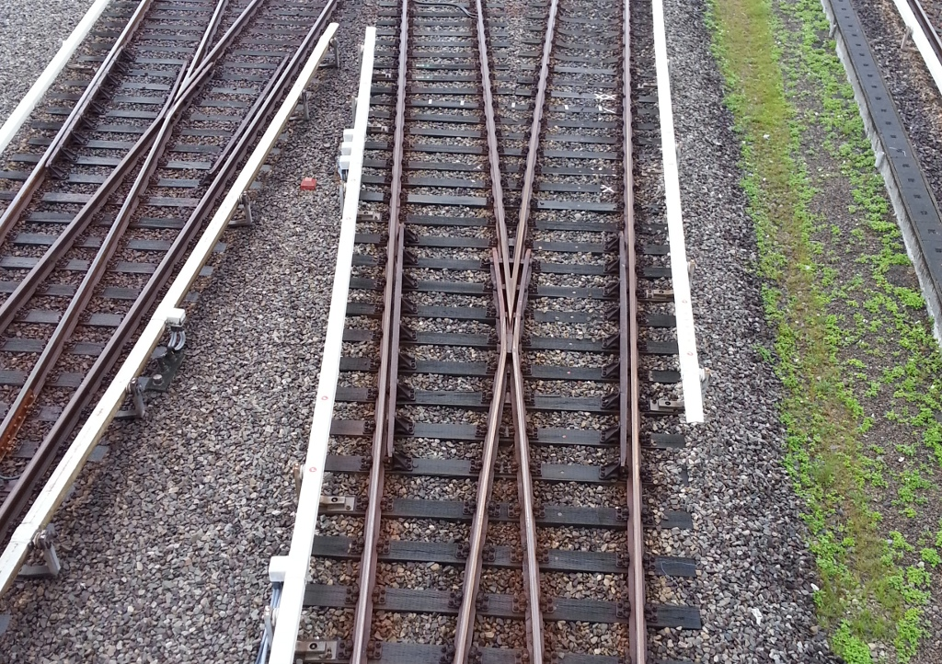

Slide 29

We hope that ezgo X is a turning point, one that can help people change their way.
In Chinese slogan, we told people to “stride across, and you may find new possibilities”.
We may not necessarily see anything special or beautiful if we stride across from this path to the other, but it is certain that if we don’t step out to cross the railway we will never see a different view.

Slide 30
ezgo11
If you are interested in the designing concept of our next version, ezgo 11, please do contact me. We’d like to hear your ideas and thoughts.

Slide 31
千里之行始於足下
A thousand-miles journey
begins with
the first step.

